Slide 1









Whiteboardmaths.com
7
2
1
5
© 2004 All rights reserved

Slide 2

Similar Triangles
Similar triangles are important in mathematics and their application can be used to solve a wide variety of problems.
The two conditions for similarity between shapes as we have seen earlier are:
Corresponding sides are in proportion and
Corresponding angles are equal
Triangles are the exception to this rule.
Only the second condition is needed
Two triangles are similar if their
Corresponding angles are equal

Slide 3
These two triangles are similar since they are equiangular.
65º
70º
45º
70º
45º
50º
50º
55º
75º
These two triangles are similar since they are equiangular.
= 180 – 125 = 55
If two triangles have two angles the same, then they must be equiangular.

Slide 4
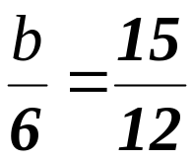
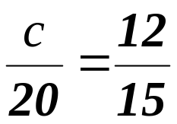
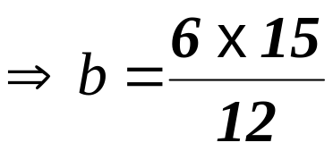
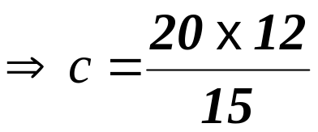


Finding Unknown Sides
b
20 cm
c
6 cm
15 cm
12 cm
Since the triangles are equiangular they are similar.
Comparing corresponding sides gives:

Slide 5
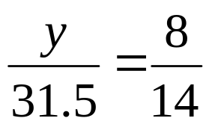
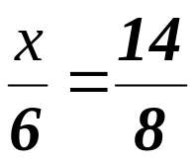
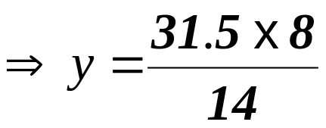
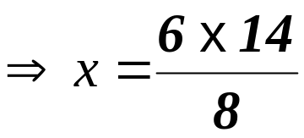


Finding Unknown Sides
31.5 cm
y
x
6 cm
14 cm
8 cm
Since the triangles are equiangular they are similar.
Comparing corresponding sides gives:

Slide 6
Determining similarity
A
B
Triangles ABC and DEC are similar. Why?
C
Angle ACB = angle ECD (Vertically Opposite)
Angle ABC = angle DEC (Alt angles)
E
D
Angle BAC = angle EDC (Alt angles)
Since
ABC
is similar to
DEC
we know that corresponding sides are in proportion
AB→DE
BC→EC
AC→DC
The order of the lettering is important in order to show which pairs of sides correspond.

Slide 7
If BC is parallel to DE, explain why triangles ABC and ADE are similar.
A
Angle BAC = angle DAE (common to both triangles)
B
C
Angle ABC = angle ADE (corresponding angles between parallels)
D
E
Angle ACB = angle AED (corresponding angles between parallels)
A line drawn parallel to any side of a triangle produces 2 similar triangles.
A
A
B
B
D
E
D
E
C
C
Triangles EBC and EAD are similar.
Triangles DBC and DAE are similar.

Slide 8


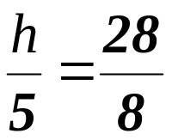
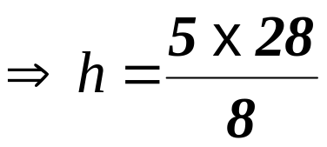

A tree 5m high casts a shadow 8 m long. Find the height of a tree casting a shadow 28 m long.
Example Problem 1
Explain why the triangles must be similar.
5m
h
8m
28m

Slide 9
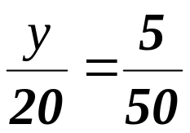
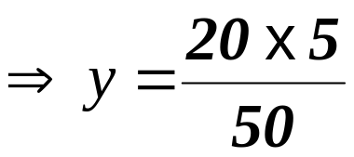

Example Problem 2
The two triangles below are similar. Find the distance y.
C
B
20m
y
A
5m
E
45m
D

Slide 10
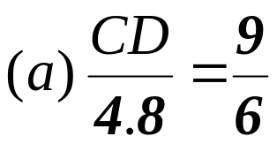
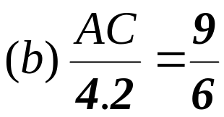
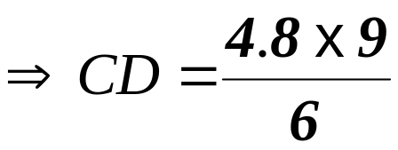
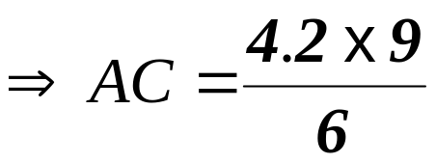


Example Problem 3: In the diagram below calculate (a) the length CD. (b) The perimeter of the trapezium EBCD.
A
A
4.2 m
6 m
6.3m
9 m
B
E
4.8 m
2.1 m
3 m
C
D
7.2m
C
7.2m
D
∴BC = 6.3 - 4.2 = 2.1 m
Perimeter of trapezium = 7.2 + 3 + 4.8 + 2.1 = = 17.1 m

Slide 11




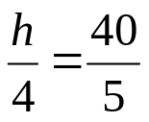
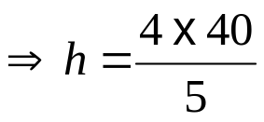

Question 1: Peter had a 4m tall tree planted 5m away from his house. The tree just blocked from view a church spire 40m away. Calculate the height (h) of the spire?
h
4m
5m
40 m

Slide 12


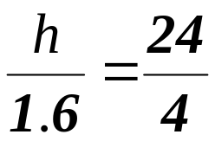
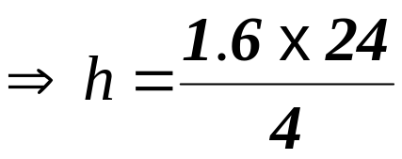

Question 2: Use similar triangles to determine the height (h) of the building.
1.6 m
20 m
4 m

Slide 13
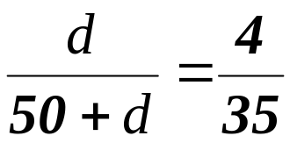




Example Question 3: Becky had a 4m tall tree planted near her house. The tree just blocked from view a church spire 35m high and 50m from the tree. Calculate the distance (d) of the tree from the house.
35 m
4m
d
50 m

Slide 14
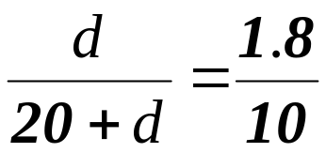




Question 3: Use similar triangles to determine the distance (d) of the man from the base of the tree. (to the nearest cm)
10 m
1.8 m
20 m
d

